Slide 1

Auto Scaling in Kubernetes
Neha Bhoi
Liam Nguyen
1

Slide 2
Overview
Kubernetes: Container Orchestration Platform
Kubernetes's Architecture
Scaling Mechanism
Horizontal Scaling
Vertical Scaling
Cluster Autoscaler
2

Slide 3
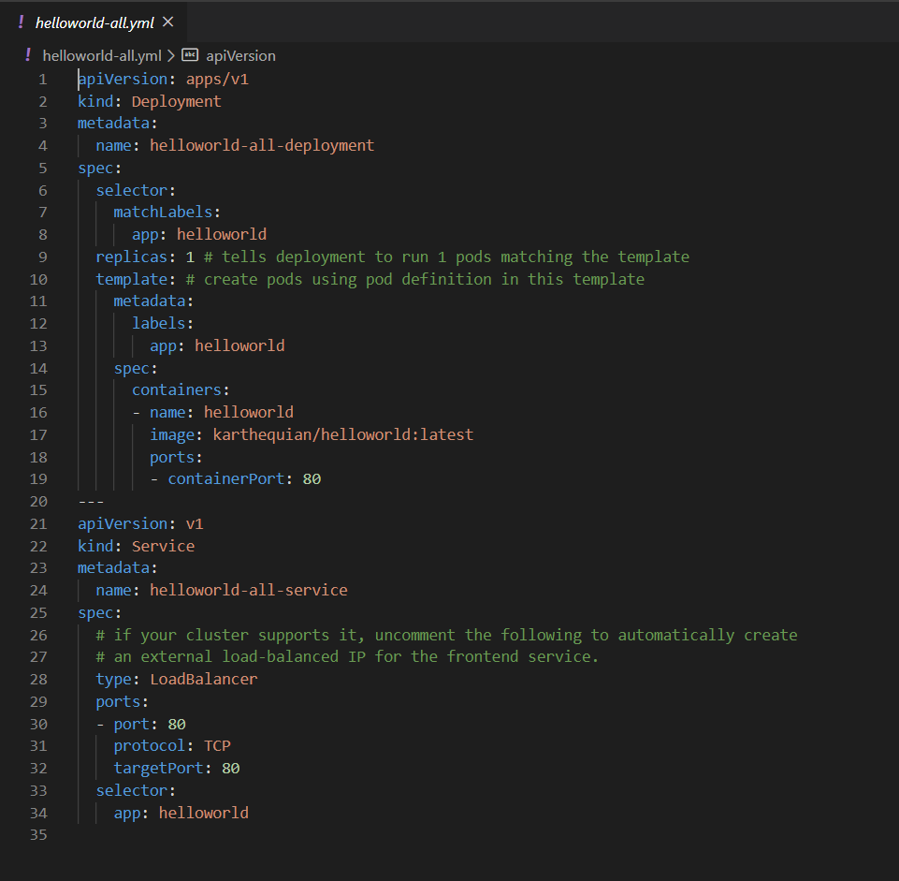
YAML
Must match this label
Pods per deployment
YAML Ain't Markup Language
Use to creat/configured Kubernetes' resources
Kubernetes will validate YAML file input
If it’s valid, it will create the resource if not existed or apply the reconfiguration to running resources
Command:
kubectl apply –f [filename]
Pod spec / Template
3

Slide 4
Demo
4

Slide 5

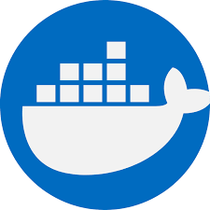
Installation and configuration of Kubernetes on local machine.
Install Kubernetes
Install Docker
Note: Enable Virtualization
5

Slide 6
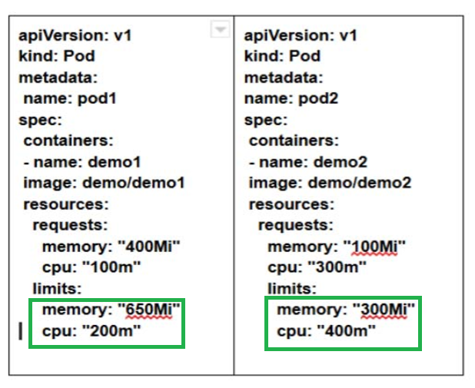
What is the issue with current scheduling
Consider a node with Capacity (900m, 1800mi)
pod1 can consume up to (200m, 650mi)
pod2 can consume up to (400m, 300mi)
At least (300m, 850mi) remain unused.
Developer has to guess and configure limits of deployments beforehand.
Kubernetes is not able to change limit dynamically after YAML file is applied.
6

Slide 7
Solution
Model and integrate three different fair allocation algorithms
DRF : Dominant Recourse Fairness.
MLF-DRS : Multi-level Fair Dominant Resource Scheduling.
FFMRA: A Fully Fair Multi-Resource Allocation Algorithm.
Trying to dynamically assign resource limits fairly among different pods running in a speciﬁc node.
7

Slide 8
DRF : Dominant Recourse Fairness.
DRF takes into account only dominant resources
Two users A and B submit tasks
where c and m denotes CPU and memory.
Calculate dominant resource.
domA = max(dcA/Cc, dmA/Cm)
domB = max(dcB/Cc, dmB/Cm)
The allocation of resources are determined as the following optimization problem.
max (A, B) while staying in the capacity
ratio between dominant features are equal
node capacity (Cc, Cm)
demand vector (dcA, dmA) and (dcB, drB).
8

Slide 9
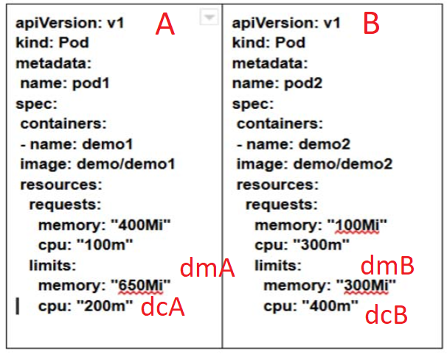
DRF : Example
A node with the capacity of (900m,1800mi)
The dominant resource for pod 1 (A) is memory and pod 2 (B) is CPU.
domA = max (200/900, 650/1800) = max(0.2, 0.36) = 0.36 => Memory
domB = max (400/900, 300/1800) = max(0.44, 0.167) = 0.44 => CPU
DRF assigns resource limits:
pod 1 (A) : (300m,1200mi)
pod 2 (B) : (600m,200mi)
Optimization equation:
max(A, B)
cA + cB ≤ Cc
mA + mB ≤ Cm
dmA / Cm = dcB / Cc
9

Slide 10
MLF-DRS - Multi-level Fair Dominant Resource Scheduling
MLF-DRS determines dominant and non-dominant resources as well.
MLF-DRS considers fair share of resources
fc = Cc / n and fm = Cm / n, n = # of pods in the node
Ex: Cc = 900m => fc = 450m
Ex: Cm = 1800mi => fm = 900mi
Two users A and B submit task to a node with the capacity of the resources is Cc and Cm
Demand vector (dcA, dmA) and (dcB, drB).
Ex: (100m, 400mi) and (300m, 100mi)
MLF-DRS calculates non-dominant resources of users
nondomA = min(dcA / Cc, dmA / Cm)
Ex: nondomA = memory
nondomB = min(dcB / Cc, dmB / Cm)
Ex: nondomB = cpu
10

Slide 11
MLF-DRS : Continue
At the ﬁrst stage, dominant resources get a fair share of resources if (dAc <= fc, dAm <= fm) and (dBc <= fc, dBm <= fm)
Ex: User A gets CPU request
Ex: User B get Memory request
Otherwise, dominant resources get initial requested resources.
For the next level, allocated resources for users A and B are denoted by (XcA, XmA) and (XcB, XmB) respectively.
11
Notes:
Non-dominant resources are allocated only what they have requested.

Slide 12
MLF-DRS : The allocation calculation
Memory allocation for non-dominants :
UserA: ((Cm−(XmA+XmB))∗XmA)/(XmA+XmB)
Memory allocation for dominants :
UserB : ((Cm −(XmA + XmB))∗fc)/(XmA + XmB)
CPU allocation for non-dominants:
UserA: ((Cc −(XcA + XcB))∗XcA)/(XcA + XcB)
CPU allocation for dominants:
UserB = ((Cc −(XcA + XcB))∗fc)/(XcA + XcB)
12

Slide 13
Weakness of MLF-DRS
MLF-DRS considers both dominant and non-dominant resources
But, it tries to equalize both dominant and non-dominant resources in entire resource pool to provide a totally fair allocation of resources.
13

Slide 14
FFMRA: A Fully Fair Multi Resource Allocation Algorithm
It determines dominant and non-dominant resources
Calculate dominant resource.
domA = max(dcA/Cc, dmA/Cm)
Ex: UserA = CPU
domB = max(dcB/Cc, dmB/Cm)
Ex: UserB = Memory
Calculates non-dominant resource.
nondomA = min(dcA/Cc,dmA/Cm)
Ex: UserA = Memory
nondomB = min(dcB/Cc,dmB/Cm)
Ex: UserB = CPU
14

Slide 15
FFMRA : Continue
It sums up together all dominant resources and non-dominant resources of all users of the entire server.
Sdom = domA + domB
Ex: Sdom = 400 + 300 = 700
Snondom = nondomA + nondomB
Ex: Snondom = 100 + 100 = 200
Sc = Cc + Cm
Ex: Sc = 900 + 1800 = 2700
St = Sdom + Snondom
Ex: St = 700 + 200 = 900
The total capacity of the resource pool is divided proportionally among dominant and non-dominant resources indicated by Pdom and Pnondom respectively.
Pdom =(Sc ∗ Sdom) / St
Ex: Pdom = (2700 / 900) * 700 = 2100
Pnondom =(Sc ∗ Snondom ) /St
Ex: Pnondom = (2700 / 900) * 200 = 600
15

Slide 16
FFMRA : Continue
The divided share for CPU and memory in the resource pool denoted by Shc and Shm respectively are determined as follows:
Shc = ( Pdom ∗ Cc) / Sc
Ex: Shc = (2100 / 2700) * 900 = 700
Shm = ( Pdom ∗ Cm)/ Sc
Ex: Shm = (2100 / 2700) * 1800 = 1400
15

Slide 17
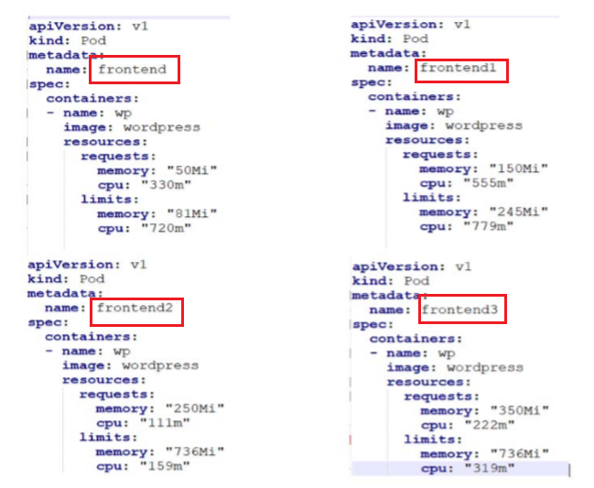
Practical Example of the proposed model
The total capacity of the CPU and Memory are 2 and 2,038,624ki
2 is the number of CPU core equals to 2000m
The memory equals to (2038624/1024=1990mi).
Frontend and frontend1 have dominant resource in CPU
Frontend2 and frontend 3 have dominant resource in memory
16

Slide 18
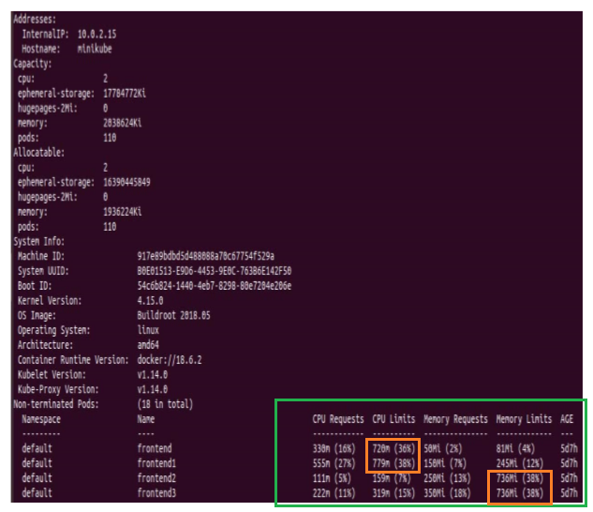
Allocated resource
First two applications with dominant resource in CPU get 36% and 38% respectively.
Last two applications which have dominant resource in Memory, they get exactly 38% of resource limits.
17

Slide 19
Conclusion
Kubernetes doesn’t allocate resources dynamically after pods are scheduled.
Proposed a model to calculate and assign resource limits fairly among the pods.
While designing, integrated three different fair allocation policies, DRF, MLF-DRS and FFMRA.
18

Slide 20
Thank You!
Q & A
19

